Slide 1
Photosynthesis phenomenon
Why do fall leaves fall?

Slide 2
Once a year phenomenon!
https://binged.it/2NBZJQB
Why does this happen? Why do leaves change color and fall off the tree?
Discuss with your table group.

Slide 3
What do all cells need? ENERGY!!
How do animal cells get energy?
How do plant cells get energy?

Slide 4
What is the source of energy for the plant?
SUNLIGHT

Slide 5
What else do plants need to survive?
WATER

Slide 6
What do we know about plants and Carbon Dioxide? Oxygen?
This Photo by Unknown Author is licensed under CC BY-SA

Slide 7
What do plants produce?
This Photo by Unknown Author is licensed under CC BY-SA
Hint… there is an input and an output…

Slide 8
How does the amount of sun and water effect the leaves on the tree? Why do leaves change color in the fall?
https://www.youtube.com/watch?v=Xk4-6II8l5Q&feature=youtu.be

Slide 9
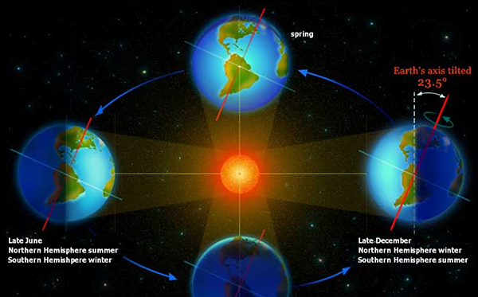

Slide 10
Write an equation for photosynthesis using any of the variables we discussed:
What plants need:
What plants produce:
Sunlight
Water
Carbon Dioxide
Dirt
Nutrients
Roots
Warmth
Chlorophyll
Chloroplasts
Energy
Growth
Fruit
Vegetables
Nutrients
Oxygen

Slide 11
https://youtu.be/qYv3tbyquWk
Let’s get ready to explore the amazing everyday phenomenon of photosynthesis!

Slide 13
