Slide 1
Formal Langauge, Informal Langauge, and Slang

Slide 4
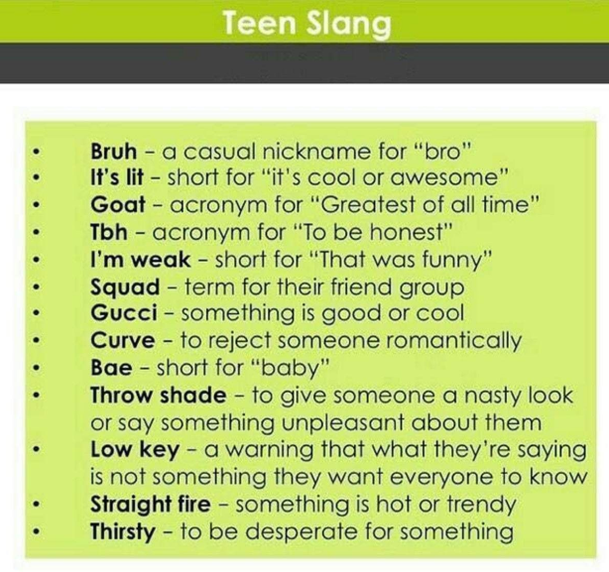

Slide 5
